Slide 1
Where would I live in Melbourne?

Slide 2

Why is it tough to find a home?
Cost of homes
Am I in the right neighborhood?
Are there enough stores around me?
Is it close to work?
Is it close to the CBD?
Do I like the house?
These factors are enough to make anyone go crazy.

Slide 3

What does this study do for you?
The study reviews the 100 most expensive neighborhoods in Melbourne and analyses which neighborhoods are the most ideal.
Magic huh?

Slide 4
How does the study work?
The study uses the average price of every 2-bedroom house in the top 100 most expensive neighborhoods and counts the number of essential services needed to make your life better.
It then creates 5 clusters these neighborhoods to provide you with the best set of neighborhoods to move into.

Slide 5

Wait, what are essential services?
These are services like number of restaurants, arts and entertainment venues, metro stations, shopping malls, sports venues, clothing stores and Medical Centers.
Obviously bars too!

Slide 6
What did the study find?
It found that neighborhoods are closely matched on price but on differ on the number of essential services offered.
It found that number of metro stations in clusters 1,2,4 and 5 but 3 has a high amount of metro stations
Cluster 2 had a low number of essential services
Clusters 3 and 4 had a high number of essential services.

Slide 7
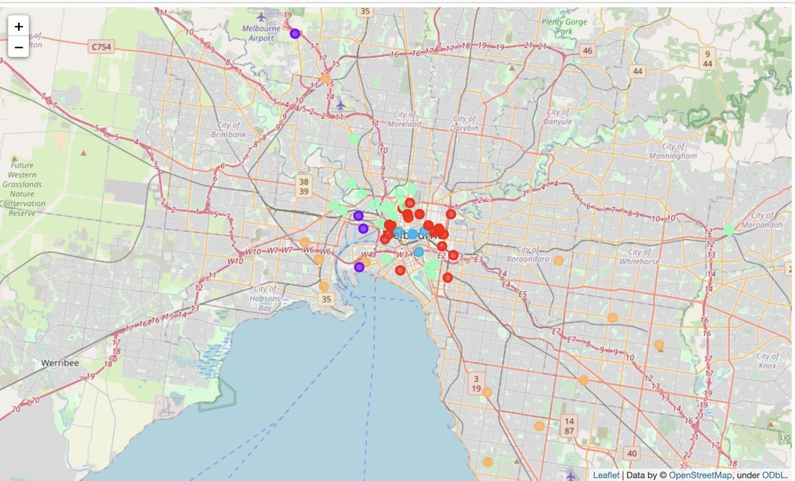
Let’s look at the clusters!

Slide 8
So finally, where would I live in Melbourne?
I would live in clusters 3 and 4. They have a high number of essential services and are centrally located.
As we know in real estate, location is key.
Let’s look at all the neighborhoods in clusters 3 and 4.

Slide 9
Cluster 3
Burnley
Brighton
Brighton East
Windsor
Forest Hill
Preston

Slide 10
Cluster 4
Princes Hill , Moonee Ponds,
Parkville , Ringwood,
Abbotsford , Ascot Vale,
Armadale, Flemington,
Port Melbourne , Clayton ,
Essendon West,
Hampton
Frankston South
Toorak
South Yarra
Croydon
Seddon
Glen Iris
Donvale
Kensington

